Slide 1

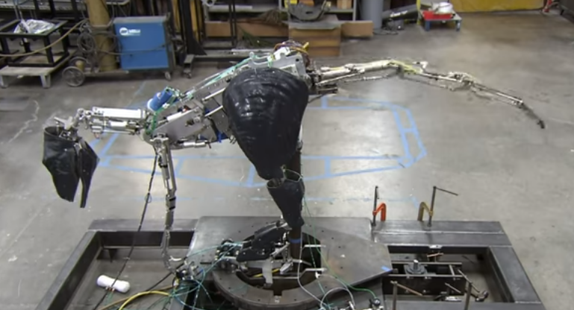
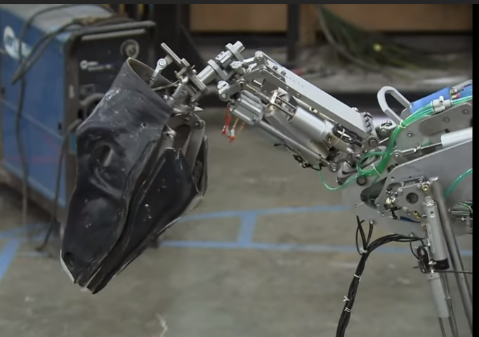
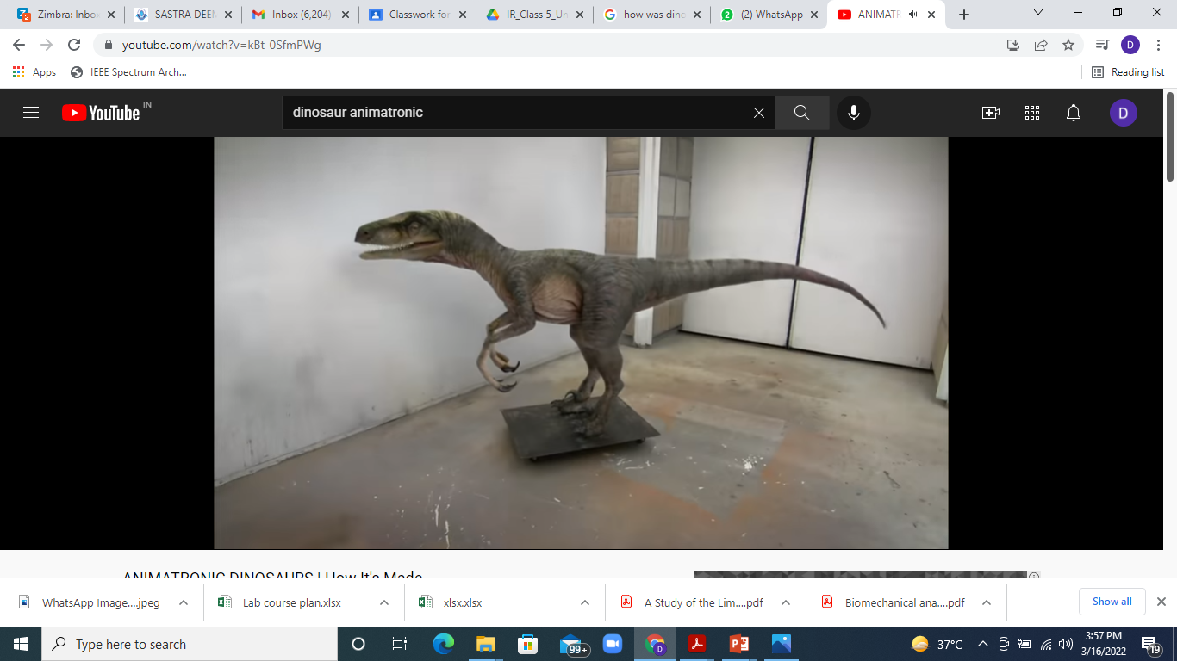
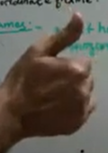
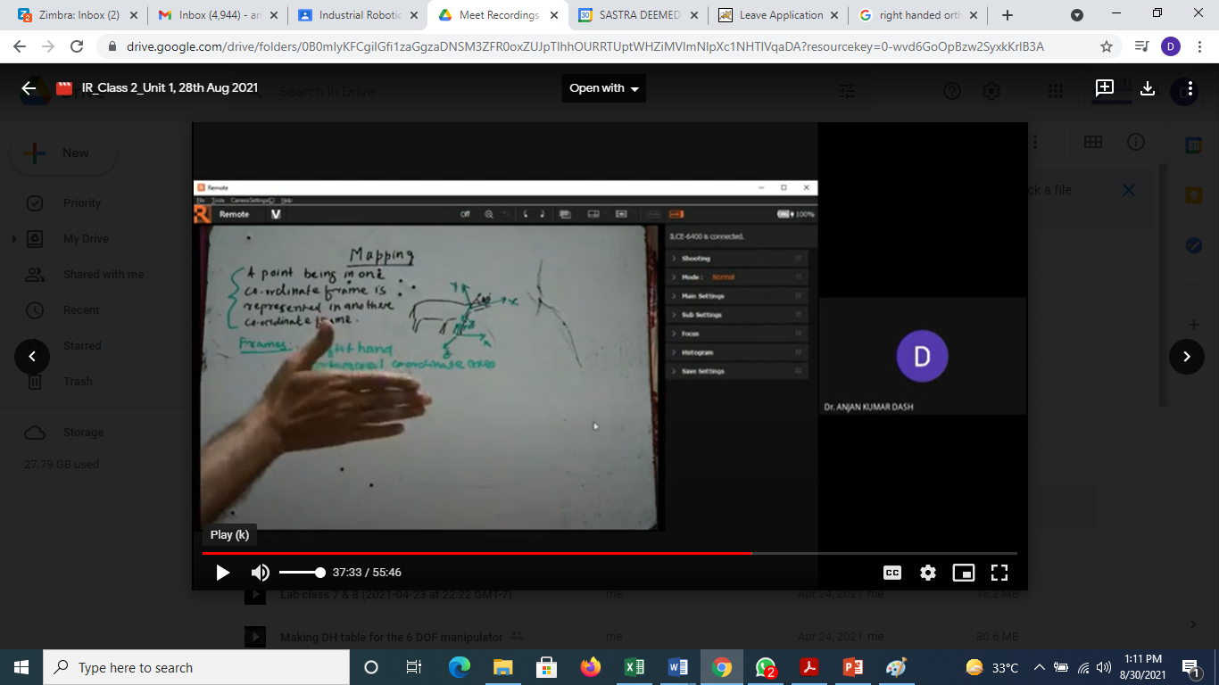
Mapping:
Source: Internet
How does one map the position of the eye, teeth etc in head with respect to the leg of this animomechatronic dinosaur?
Mapping is changing the description of a point or vector from one frame to another.
Z
Z
Z
Y
In 3D space, a coordinate frame is represented by right hand coordinate axes.
Some of the correct ways of specifying the coordinate frames are
shown below. Please fix X and Y for the following?
Y
X
Z
Z
Y
X
X
X
Z
Y
Z
Z
X
1
Y

Slide 2
How to represent a point P in space?
Z
A point P is located in a XYZ frame. It is defined by the following way
where 1p_{x,} 1p_{y,} 1p_{z} are the projection of vector P on X, Y and Z axes respectively and
are the direction vectors.
P
1_{p}
Y
z
1_{p}
1_{p}
X
1_{p}
y
x
Mapping between two frames can be of three types:
When frames 1 and 2 are rotated with respect to each other
When frames 1 and 2 are translated with respect to each other
When frames 1 and 2 are translated and rotated with respect to each other

Slide 3
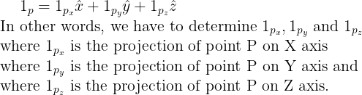
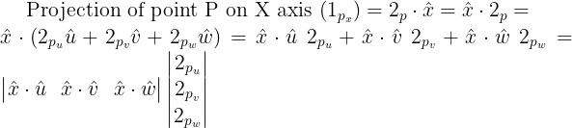
Mapping between frames when they are rotated with respect to each other:
Given 2_{p} determine, 1_{p}
Z
v
w
{1}
{2}
P
Y
………(1)
u
X
………(2)

Slide 4
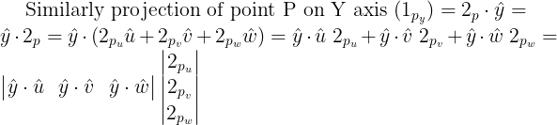

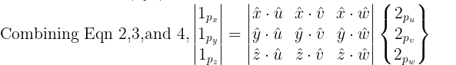
………(3)
………(4)

Slide 5
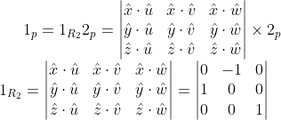

Let us take an example
{1}
Y
Point P is defined in frame 2 (‘uvw’ frame) with coordinates (10,-4,0).
Determine the coordinates of the same point in frame 1 (‘XYZ’).
u
4 Units
By observation:
P
By mere observation, the coordinates of point P in frame 1 (XYZ)
will be (4,10,0).
10 Units
By applying principle of mapping:
X
v
Here 2_{p} is given (10,-4,0), determine 1_{p} where frame 2 is ‘uvw’ frame and frame 1 is
‘XYZ’ frame.
We know
w
{2}
Z
(Note that x and u are perpendicular to each other; so
their dot product is zero; x and v are opposite to each
other (180º ); so their dot product is -1; similarly all others.)

Slide 6
Z
{1}
In the figure shown, a frame is attached to the head of the dinosaur. In this
frame the left eye has the coordinate of (10,6,4). If the dinosaur rotates his head
by 90º about Z axis (towards his left), what will be the new coordinates of the
eye?
X
Y

